Slide 1
Index Laws Review
EQ: How are index laws used with algebraic expressions

Slide 2
Learning Intentions
Students will be able to
define and use the index laws

Slide 3
You will need to draw or will be given the following placemat. This will go on your notes side of the Cornell notes

Slide 4






Index laws

Slide 5
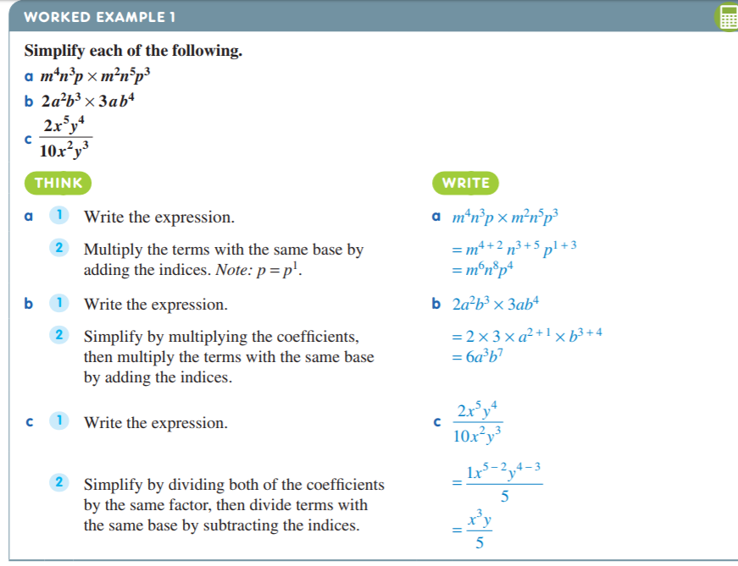
Teacher notes- to guide creation of Index Laws placemat

Slide 6
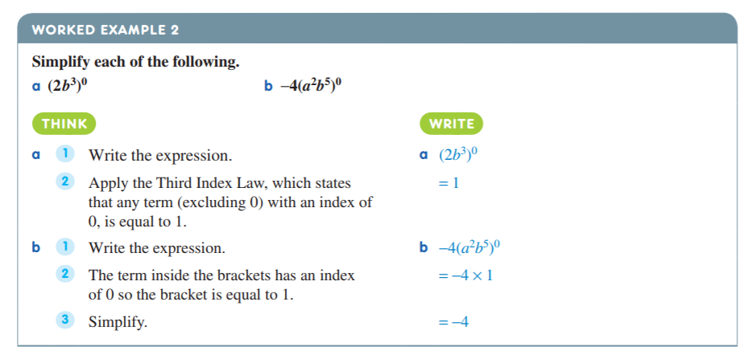
Teacher notes- to guide creation of Index Laws placemat

Slide 7

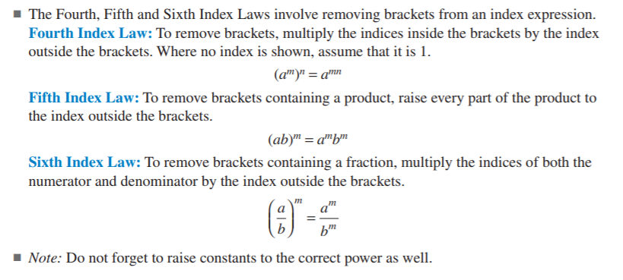
Teacher notes- to guide creation of Index Laws placemat

Slide 8
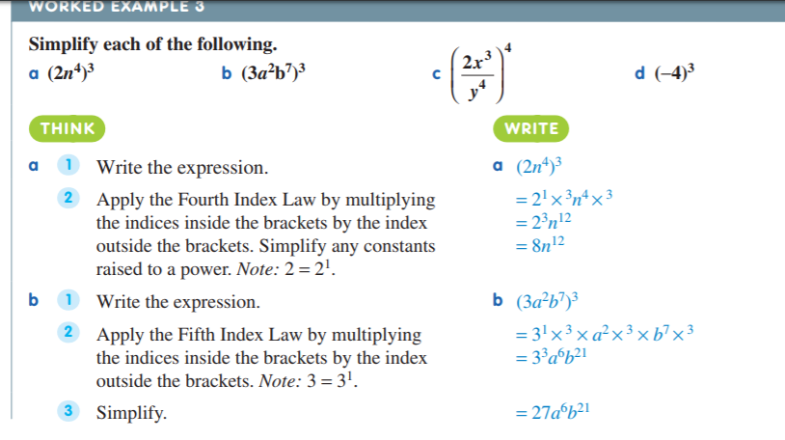
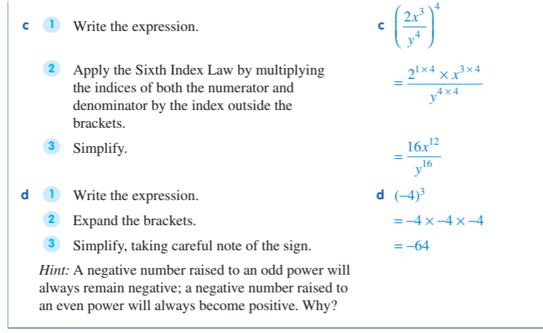
Teacher notes- to guide creation of Index Laws placemat

Slide 9
Complete Reviewing index laws worksheet double sided

Slide 10
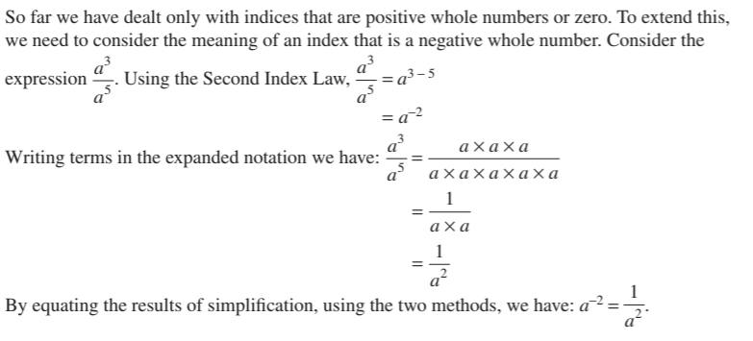
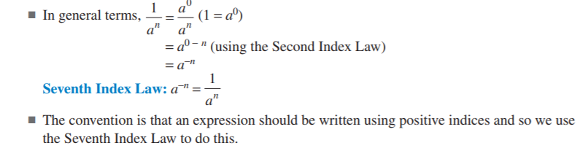
Teacher notes- to guide creation of Index Laws placemat
Negative Indices

Slide 11
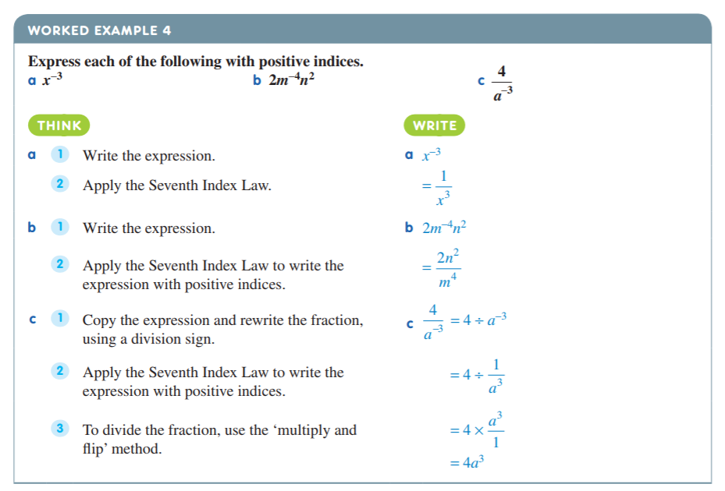
Teacher notes- to guide creation of Index Laws placemat
If you have a negative above the line drop down and make positive (invert)

Slide 12

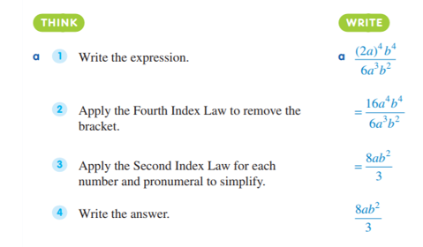
Teacher notes- Use this example for students to write this example into their Cornell notes
Combining Index Laws
In most practical situations, more than one index law is needed to simplify the expression.

Slide 13
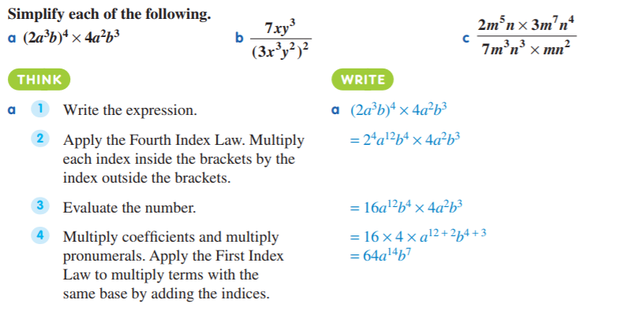
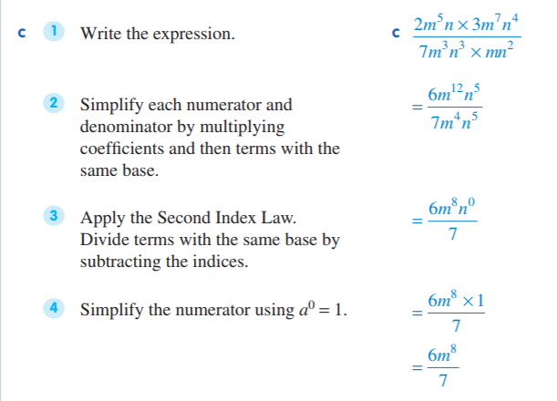
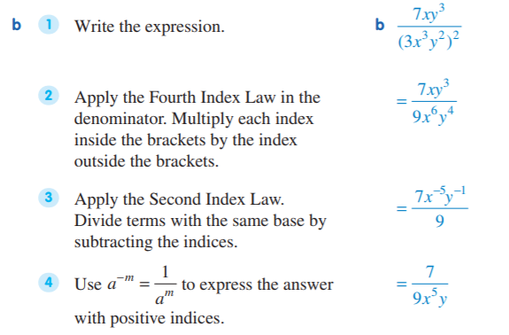
Teacher notes- Use this example for students to write this example into their Cornell notes
Combining Index Laws

